Slide 1



INTERNAL HACKATHON 1.0- 2024
AI- POWERED FRAUD DETECTION IN FINANCIAL TRANSACTION
Team- Binary Bytes
Team Members
Anil Yadav- AI&ML /2ⁿᵈ year
Anshul Verma- AI&ML /2ⁿᵈ year
Anirudh Raturi- AI&ML /2ⁿᵈ year
Abhishek Bhatt- AI&ML /2ⁿᵈ year

Slide 2
Introduction
02
Problem Statement: Credit card fraud has become one of the most significant challenges in the financial industry. With millions of transactions happening every minute, detecting fraudulent activities in real-time is crucial to prevent financial losses and protect customer trust.
Why It’s Important
Fraudulent transactions cost financial institutions and consumers billions of dollars every year.
Manual monitoring is slow and prone to human error, leading to increased false positives and false negatives.
Key Goal: Our goal is to develop an AI-powered system that detects fraudulent transactions in real-time, ensuring quick responses to suspicious activities and minimizing financial damage.

Slide 3

Scope and Features
03
Scope
Real-time detection of credit card fraud.
Focus on minimizing false positives for better user experience.
Handle various types of financial fraud (credit card, identity theft).
Key Features
Transaction pattern analysis to identify suspicious behaviors.
Anomaly detection to flag unusual activities.
Automatic alerts for real-time fraud notification and action.

Slide 4
Data Collection and Preprocessing
04
Data Sources
Kaggle Credit Card Fraud Dataset: A publicly available dataset that contains historical transaction data labeled as fraudulent or non-fraudulent.
Simulated Data: Generated additional data using tools like Faker to create realistic transaction scenarios for testing our model.
Preprocessing Steps
Data Cleaning: Identified and handled missing values, removed outliers, and corrected inconsistencies to ensure data quality.
Normalization: Scaled transaction amounts and other numerical features to ensure consistent model performance across varying ranges.
Feature Engineering: Created new features such as:
Transaction time
Transaction amount

Slide 5
Fraud Detection Algorithm
05
Models Used
Logistic Regression and for classification.
Training Approach
Train-Test Split for model evaluation.
Hyperparameter Tuning to optimize performance.
Key Metrics
Precision: Accuracy of fraud detection (99.92 %).
Recall: Ability to capture fraud cases.
F1 Score: Balances precision and recall.

Slide 6
06
Future Real-time Detection SystemPlanning
System Components
Transaction Data Stream: Real-time data input to monitor and detect suspicious transactions.
Fraud Detection API: Built using Flask/Django, the API processes transaction data and assigns fraud risk scores.
Decision Logic
Twilio SMS Alerts: Automatically sends SMS notifications to admins or users when fraudulent transactions are detected, using Twilio.
Technologies Used
Message Queues (e.g., Kafka, RabbitMQ) to process large transaction volumes.
Flask for API development and integration.
Twilio for real-time SMS alerts.

Slide 7
07
Alerting and Reporting System
Fraud Alerts
Twilio SMS Integration: Sends instant SMS alerts to admins and users when suspicious transactions are flagged.
Reporting Dashboard:
Transaction Overview: Displays total transactions, flagged fraud cases, and false positives.
Fraud Trends: Visualizes patterns and anomalies over time, helping to improve the detection system.
Performance Metrics: Shows the system's accuracy, precision, recall, and F1 score for continuous monitoring and improvement.

Slide 8
08
Security and Deployment
Security
Data Encryption: Protect sensitive transaction details.
Secure API: Use HTTPS for safe communication.
Deployment
AWS/Heroku: Cloud hosting for handling large-scale transactions.

Slide 9
09
Testing and Validation
Testing Process
Mock Transactions: Simulated transactions are run through the system to verify fraud detection accuracy.
Performance Testing: Ensures the system can handle high transaction volumes without lag or errors.
Validation Metrics
Accuracy: Percentage of correctly identified fraud cases.
False Positives: Focus on minimizing the number of legitimate transactions flagged as fraudulent.
Model Tuning: Regularly fine-tuning the model to improve detection rates and reduce errors.

Slide 10
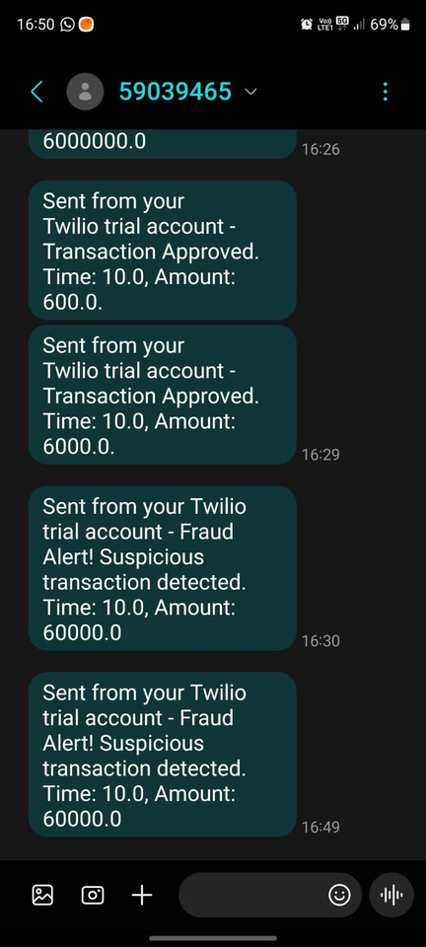
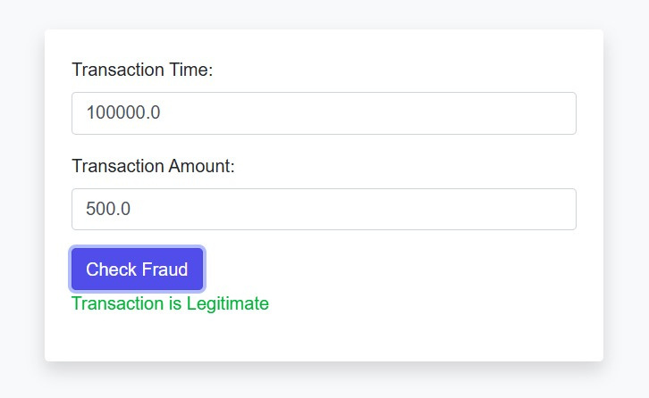
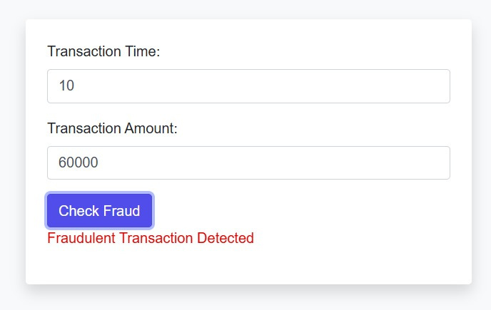
Fraud Detection in Action
10
(i) When the transaction is legit
(ii) When the transaction is fraud

Slide 11

07

